Slide 1
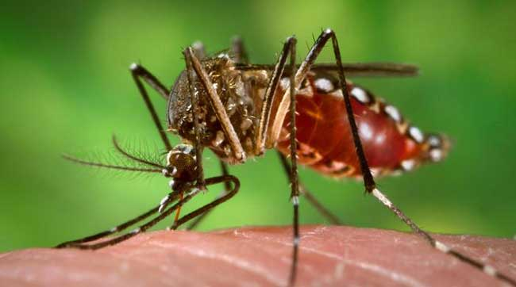
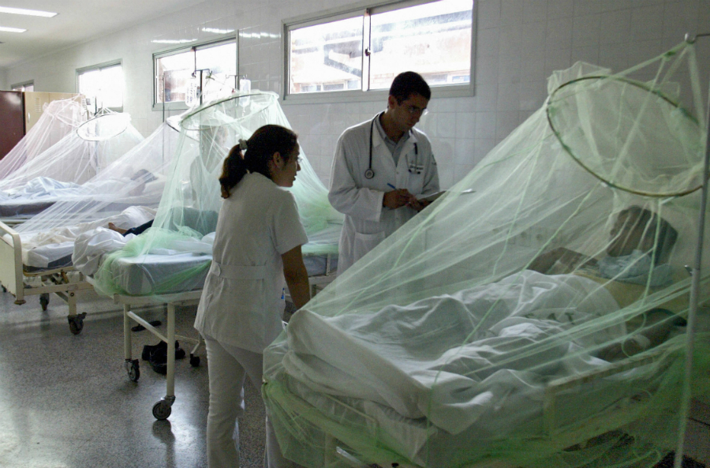
National Guideline for clinical Management of
Dengue Syndrome
5th Edition 2020(Revised)
Dr. Md. Ahsan Ali Sarkar
Assistant registrar
Department of Medicine ,RpMC

Slide 2
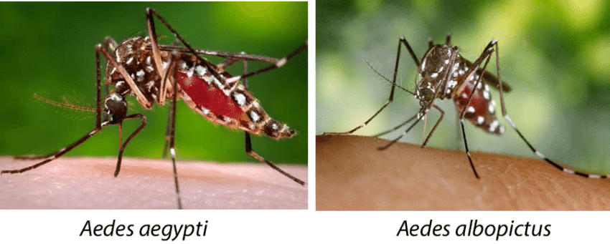

Slide 3
Introduction
Dengue is an arbovirus, which has four serotypes
Transmitted by Aedes mosquito (Aedes. Aegypti & Aedes. Albopictus)
Infection with one serotype confers lifelong immunity to that serotype and cross immunity to other serotypes for 2-3 months
Secondary infections with different serotypes causes more severe form of disease

Slide 4
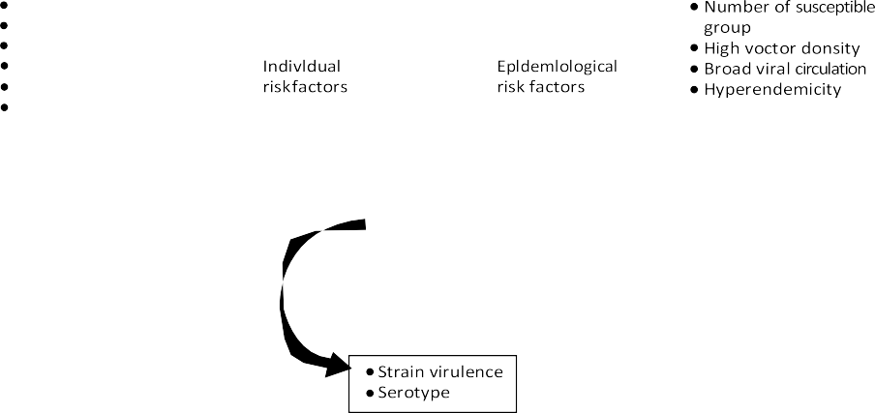
Epidemiological triad
Age
Sex
Race
Nutritional status
Secondary infection
Host response
Viral factors

Slide 5
Dengue Case Burden in Bangladesh
The first epidemic of DHF occurred in mid-2000 with 5,551 cases & 93 deaths
According to WHO, the worst outbreak occurred in 2002, with 6,232 cases and 58 deaths
In the year 2019 dengue case burden was the worst with 101354 cases and 179 deaths
In last 5 years(2015-2019) average cases were 24614 and average deaths were 41-42

Slide 6
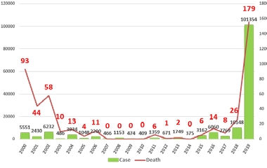
Figure :Number of Dengue Cases and Death in Bangladesh (2000-2019)

Slide 7
Pathogenesis of Dengue infection
Immune system plays a key role
Various mechanisms of severe disease have been suggested, including:
  Antibody-dependent enhancement or ADE,
  T-cell mediated immunopathology,
  Complement activation by virus-antibody complexes and
  Cytokine abundance

Slide 8
Pathophysiology of Dengue Infection

Slide 9
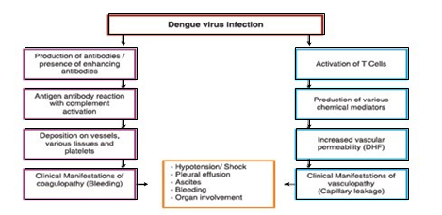

Slide 10
Clinical Manifestation of Dengue Infection
    Undifferentiated fever
    DF
    DHF
    Expanded Dengue Syndrome (rare)

Slide 11
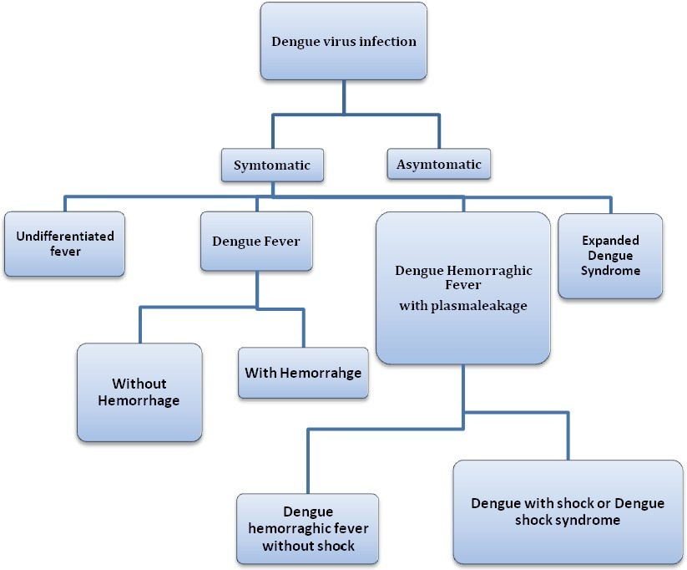

Slide 12

Natural course of Dengue Hemorrhagic fever
Day 1
2
3
4
5
6
7
8
9
Fever
Shock
Pleural effusion Ascites
Haematocrit
90
Plasma leakage
Leakage stop
Reabsorption
W
B
C
IV fluid: NSS, DAR, DLR
Colloid: 10% Dextran-40
M+5% Deficit(=4600ml in adult)
Fluid overload
WBC
6000-9000
5000
Platelet count
200,000
100,00
50000
Hct
35
38
45(rising 20%)
Albumin
3.5gm%
Cholesterol
100 gm%

Slide 13
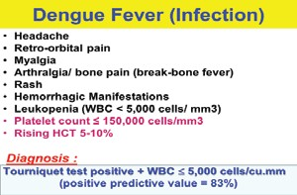

Slide 14
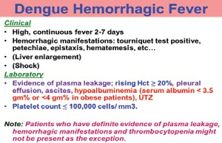

Slide 15
Differentials
Arboviruses: Chikungunya virus
Other viral diseases: Measles; Rubella and other viral exanthems; Epstein-Barr Virus (EBV); Enteroviruses; Inﬂuenza; Hepatitis A; Hantavirus.
Bacterial diseases: Meningococcemia, Leptospirosis, Entericfever, Melioidosis, Rickettsia diseases, Scarlet fever, Sepsis.
Parasitic diseases: Malaria.

Slide 16
Investigations
Indirect test:
    CBC
    Haematocrit
    SGGPT,SGOT
    Coagulation Profile
    Others
Diagnostic:
    NS1 antigen
    Anti Dengue IgM/IgG
    Nucleic acid detection test
    Dengue virus isolation

Slide 17
Management

Slide 18
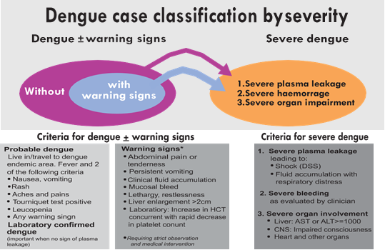

Slide 19
Dengue Case Management
Assesssment
Case classification
Group(A,B,C/Mild, Moderate,Severe)
Treatment

Slide 21
C L A S S I F I C A T I O N
Negative
Positive
Co-existing condition Social circumstances
Positive
Negative
Dengue with Warning Sign
Severe Dengue
Dengue without Warning Sign

Slide 22
G R O U P
Group A: May be sent home (Mild) GROUP A -Who may sent home Group criteria Patient Who do not have warning sign AND Who are able to tolerate adequate amount of ORAL Fluids to pass urine at least once in every 6 hours | Group B: Referred for Hospital Care (Moderate) Group B Referred for in-hospital care Group criteria Patients with any of the following features: C o- existing conditions such as pregnancy, infancy, old age, diabetes mellitus Social circumstance es such as living alone, living far from hospital OR Existing warning signs: Abdominal pain or tenderness Persistent vomiting Clinical ﬂuid accumulation Mucosal bleeding Lethargy/ restlessness Liver enlargement >2cm Laboratory: increase in Hct | Group C: Register for Emergency Treatment (Severe) Group C Require emergency treatment Group criteria Patients with any of the following features. Severe plasma leakage with shock and/or ﬂuid accumulation with respiratory distress Severe bleeding Severe organ impairment Severe Metabolic dysfunction
M A N A G E M E N T

Slide 23
Mx
Group A | Group B | Group C
Laboratory tests Full Blood Count (FBC) Hematocrit (HCT | Laboratory tests Full blood Count (FBC) Haematocrit (Hct) | Laboratory tests Full blood Count (FBC) Haematocrit (Hct) Other organ function tests as indicated

Slide 24
Treatment for Group A
Adequate rest
Adequate ﬂuid
Intake Paracetamol, 4 gram max. per nday in adults and accordingly in children
Tepid Sponging
Look for mosquito breeding place and eliminate them
patient with stable Hct can be sent home

Slide 25
Avoid to
Acetylesalicylic acid
Mefenemic acid
Ibupofen
NSAIDs
Antibiotics

Slide 26
Monitoring
Daily review for disease progression: Decreasing WBC Defervescence Warning signs
Advice for immediate return to hospital if development of any warning signs
Written advice of management
(e.g. home care card for Dengue

Slide 27
Treatment of Group B
Obtain reference Hct before ﬂuid therapy
Encouragement for oral fluid
If not tolerated, start intravenous fluid

Slide 28
Indication for I/V fluid
Patient can not have adequate oral fluid intake or is vomiting
Hct increase to 10-20% despite oral rehydration
Impending shock/ shock

Slide 29
General Principles of fluid therapy in DHF
Both crystalloid and colloids are recommended
Volume and rate should be just sufficient to maintain effective circulation
Fluid therapy should not exceed the period of plasma leakage

Slide 30
Rate of IV fluid in adults and children
Note | Children (ml/kg/hr) | Adult(ml/hr)
Half of maintenance (M/2) | 1.5 | 40-50
Maintenance | 3 | 80-100
M+5% deficit | 5 | 100-120
M+7% deficit | 7 | 120-150
M+10% deficit | 10 | 300-500

Slide 31
Fluid Management- Group B

Slide 32

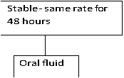
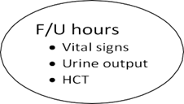
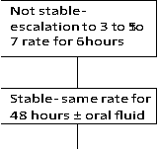


Slide 33
Fluid therapy: Group C

Slide 34
Clinical symptoms and signs in compensated and decompensated shock
Normal Circulation | Compensated Shock | Decompensated/ Hypotensive shock
Clear consciousness | Clear consciousness – shock can be missed if you don’t touch the patient | Change of mental state- restless, combative or lethargy
Brisk capillary refill time (<2 sec) | Prolonged capillary refill time (>2 sec) | Mottled skin, very prolonged capillary refill time
Warm & pink extremities | Cool extremities | Cold, clammy extremities
Good volume peripheral pulses | Weak& thread peripheral pulse | Feeble or absent peripheral pulse
Normal heart rate for age | Tachycardia | Severe tachycardia with bradycardia in late shock
Normal blood pressure for age | Normal systolic pressure with raised diastolic pressure Postural hypotension | Hypotension/unrecordable BP
Normal pulse pressure for age | Narrowing pulse pressure | Narrowed pulse pressure (<20mmHg)
Normal respiratory rate for age | Tachypnoea | Metabolic acidosis/ hyperpnoea/ Kussmaul’s breathing
Normal urine output | Reduced urine output | Oliguria or anuria

Slide 35
IV FLUID THERAY for Compensated Shock

Slide 36
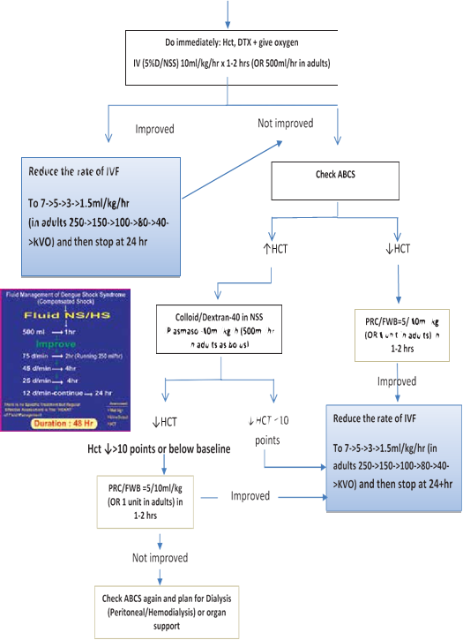

Slide 37
IV FLUID THERAY for decompensated shock

Slide 39
When stop IV fluid therapy
Cessation of plasma leakage
Stable BP, pulse and peripheral perfusion
Hematocrit decreases in the presence of a good pulse volume
Apyrexia (without the use of antipyretics) for more than 24–48 hours
Resolving bowel/abdominal symptoms
Improving urine output
Continuing intravenous ﬂuid therapy beyond the 48 hours of the critical phase will put the patient at risk of pulmonary oedema and other complications such as thrombophlebitis

Slide 40
Flow diagram for the Management of Fluid Overload

Slide 42
Special Clinical Situations
Severe dengue can be complicated with myocarditis, encephalopathy/encephalitis/ Acute liver failure, AKI, ARDS and sometimes with multi organ failure(MOF)
These complicated patients should be managed by medicine specialist/ pediatrician for comprehensive care
In myocarditis with raised trop I & ECG changes( Bradycardia, tachycardia, ST-T changes) injudicious use of antiplatelet, anticoagulant of intervention (pacemaker or others) should be avoided
In encephalitis, judicious use of steroid can be given
In hepatic encephalopathy in dengue, the management should be done as per protocol of hepatic encephalitis
For AKI, ARDS, MOF appropriate supportive care should be given

Slide 43
Haemorrhagic complications
Patients at risk of severe bleeding are those who:
  Have profound/prolonged/refractory shock;
  Have hypotensive shock and multi-organ failure
  Have pre-existing peptic ulcer disease;
  Have any form of trauma, including intramuscular injection.
  Are given non-steroidal anti-inﬂammatory agents;
  Are on anticoagulant therapy;

Slide 44
Indications for whole blood
  1.Hemoglobin level ≤ 5 gm %
  2.Significant bleeding > 10% of total blood volume (TBV). TBV of body is 80 ml/kg.
  3.Concealed bleeding manifested by Hct drop and unstable vital signs in spite of adequate volume replacement.
  Dose of whole fresh blood: 10 ml/kg/dose at a time.
Indication for platelet concentrate
  1.Very severe Thrombocytopania who need urgent surgery
  2.Clinical judgement of the treating physician

Slide 45
Case Classification of Co-infection Dengue and COVID-19
Co- infection Covid-19 & dengue
│
─
│
Asymptomatic both Covid-19 & dengue
─
─
─
─
Symptomatic either or both
│
─
─
Predominant covid-19 with mild or moderate dengue
Dengue & covid-19 Co-dominant Both are severe
│
│
─
Predominant dengue with mild or moderate covid-19

Slide 46
Management of Dengue and COVID-19 Co-infection
Fluid therapy-Fluid therapy to be given in co-infection cases depends on the hemodynamic status of patient and degree of severity
LMWH- used in moderate to severe covid-19,
    withheld if platelet count <1,00,000/cmm3 or if there is any bleeding manifestation
Steroid- Dexamethasone has recently been shown to be effective in severe COVID-19 and has been recommended for the same in co-infected patient
Tocilizumab, Antivirals and other supportive management to be continued as per the current COVID-19 guidelines

Slide 47
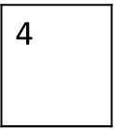
Do’s | Do not
Administration of Paracetamol for high fever and myalgia | Send patient with non-severe dengue home with no follow-up or inadequate instructions
Clinical assessment of the haemodynamic status before and after each bolus fluid | Administer acetylsalicylic acid(Aspirin) or Ibuprofen
Give intravenous fluids for repeated vomiting or ahigh rapidly rising Hct | Avoid clinical assessment of patient with repect to fluid therapy
Use the appropriate isotonic intravenous fluid for severe dengue in appropriate time and dose | Administer of intravenous fluid to any patient with mild dengue( those who can take by mouth)
Avoid Intramuscular injections | Give intramuscular injection to dengue patient
Tight glycaemic control | Avoid monitoring Blood glucose
Give appropriate colloids, PRC of Fresh Whole Blood if indicated | Give excessive fluids, blood or blood products
1
2
3
5
6
7

Slide 48
